Slide 1


MailBird
Hugh Dillon, Zac Hawkins, Rick Holloway, Ben Smith, Hunter Thorington

Slide 2
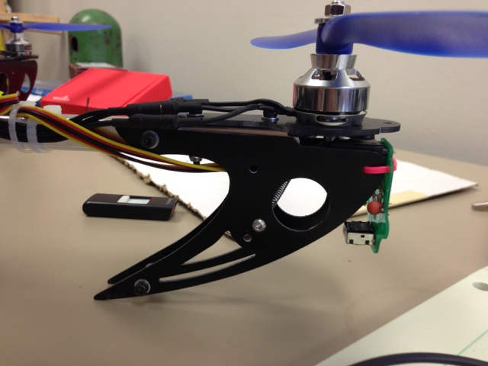
OVERVIEW
Flight mode control
MAVlink Communication
I2C and SPI Communication
Triangulation Algorithm

Slide 3
Flight mode control
Created new Roll/Pitch mode
Sets IR flag to switch between GPS and camera error.
Updates roll/pitch controller based on calculated roll/pitch from loiter controller.
Loiter controller called at 10Hz rate
Updates nav_roll and nav_pitch based on camera error.

Slide 4
MAVlink communication
A communication protocol used in small, remote vehicles.
Used for communications over telemetry or USB
Used by Mailbird to set flight mode from flight plan or long-range communication
Primary uses:
Setting the flight mode from software
Testing purposes – pymavlink, behavior patterns

Slide 5
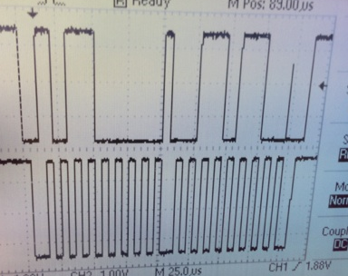
I2c
Inter Integrated Circuit Communications (I2C)
Multiple addressing. single master – multiple slaves
Repeated starts
Register initialization

Slide 6
The backup plan
Serial Peripheral Interface (SPI) – Backup plan
No addressing: single master – single slave
Testing on Arduino Duemilanove and Uno

Slide 7
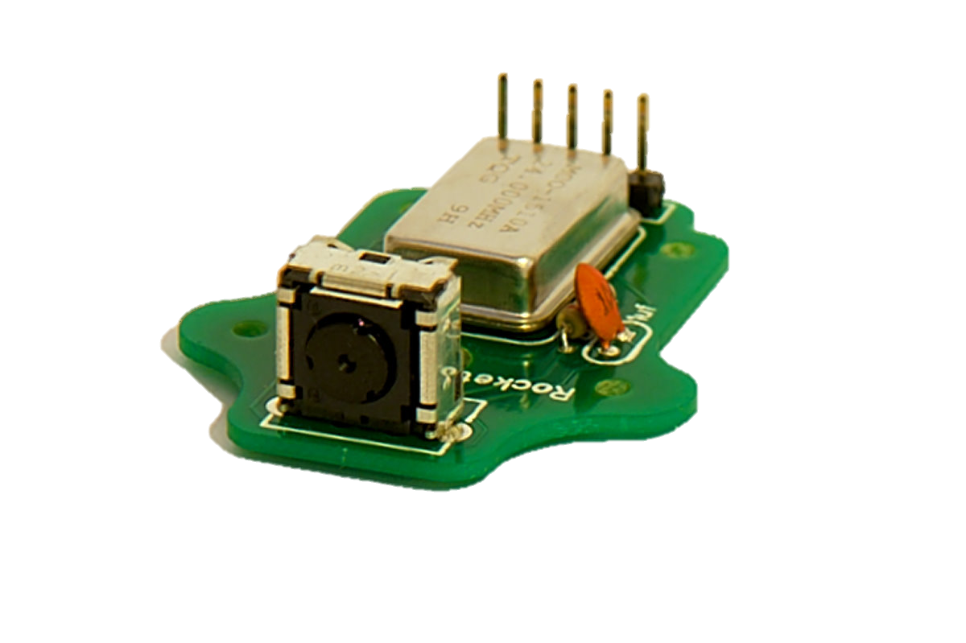
IR Camera Printed Circuit Board
Smaller
More reliable
Mounting Holes

Slide 8
Triangulation Algorithm
The triangulation algorithm allows the quad copter to determine its position over a landing pad with IR LEDs imbedded. The algorithm takes a set of two X,Y positions as inputs and outputs the quad copters x,y offset and elevation. The algorithm runs on the APM board in a 100Hz loop.

Slide 9
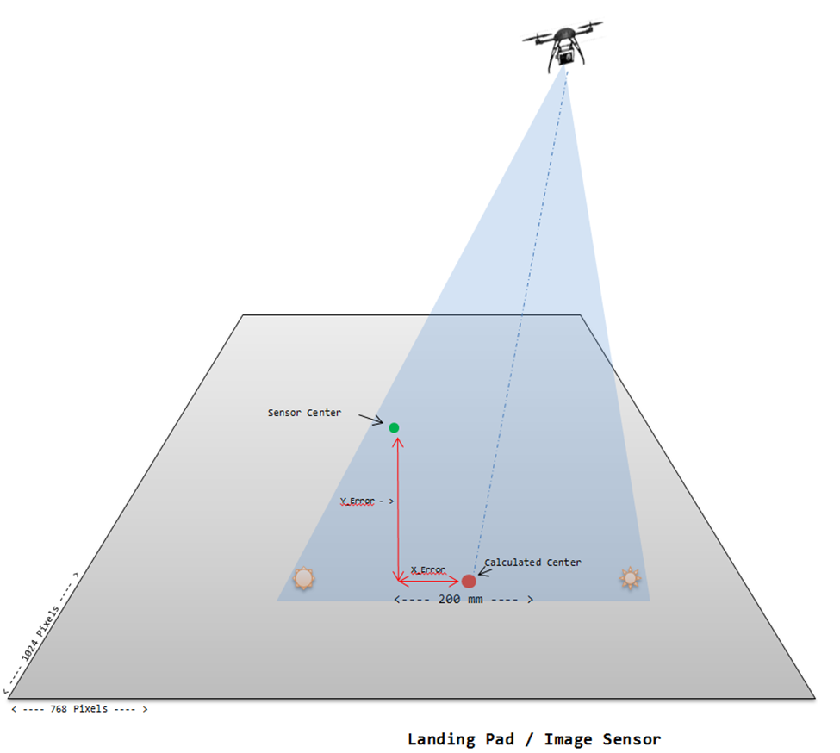

Slide 10
Potential problems
Infrared White-out
Carrying Capacity
Viewing Angles
Simulation/Testing area
Weather

Slide 11
Budget
Total budget of $50 per team member
Estimated costs: ~$225
Unexpected costs: ~$25

Slide 12
timeline
Proposal: January 22
Cycle 1: March 6
Working control algorithm
Cycle 2: April 25
Final design report by April 18
Senior Design Fair: April 25

